Slide 1
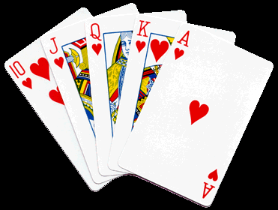
Algortihms and Data Structures: Basic Sorting
Department of informatics
Parahyangan Catholic University
Credit to: Lionov, M.Sc

Slide 2
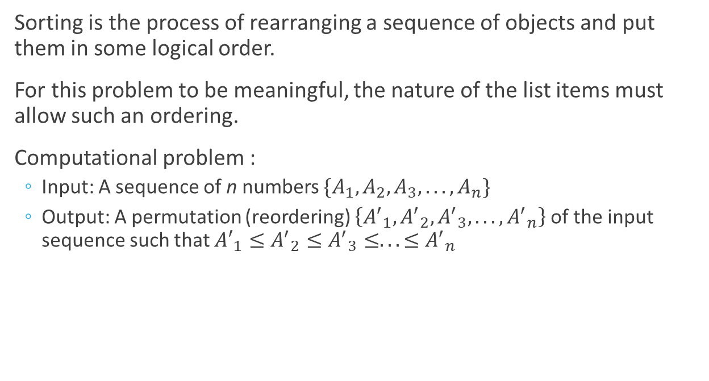
Definition
Sorting is the process of rearranging a sequence of objects and put them in some logical order.
For this problem to be meaningful, the nature of the list items must allow such an ordering.
Computational problem :
  Input: A sequence of n numbers $\{A_{1}, A_{2}, A_{3}, . . . , A_{n}\}$
  Output: A permutation (reordering) $\left\{{A^{′}}_{1}, {A^{′}}_{2}, {A^{′}}_{3}, . . . , {A^{′}}_{n}\right\}$of the input sequence such that ${A′}_{1}≤{A^{′}}_{2}≤{A^{′}}_{3}≤. . . ≤{A^{′}}_{n}$

Slide 3
Definition (2)
Example : Given the input sequence {31, 41, 59, 26, 41, 58}, a sorting algorithm returns as output the sequence {26, 31, 41, 41, 58, 59}
In practice, not only numbers: characters, strings, collection of data (records) containing a key to be sorted or any other ordered types.

Slide 4
Motivation
Sorting is the most fundamental algorithmic problem in computer science:
  Sorting is a starting point to solve other problems and basic building block for many other algorithms (ex: Greedy, Searching)
  Design of algorithms similar in sorting are effective in addressing other problems, ex: divide-and-conquer

Slide 5
Motivation (2)
  Historically, computers spent more time to sort than doing anything else. If that fraction is lower today, one likely reason is that sorting algorithms are relatively efficient, not that sorting has diminished in relative importance.
  Literally dozens of different algorithms are known, most of which possess some particular advantage over all other algorithms in certain situations.
  Sorting plays a major role in commercial data processing and in modern scientific computing.

Slide 6
Characteristics
Stable:
  Preserves the relative order of any two equal elements in its input. If an input list contains two equal elements in positions i and j where i < j, then in the sorted list they have to be in positions i’ and j’ respectively, such that i’ < j’.
In-place:
  An algorithm is said to be in-place if it does not require extra memory, except, possibly, for a few memory units.

Slide 7
Characteristics (2)
Internal-External:
  Whether there are so many records to be sorted that they must be kept in external files (on disks, tapes, etc) or whether they can all be kept internally in high-speed memory
Comparison-based:
  Comparison-based sorting works by comparing elements to be sorted.
  Non-comparison based sorting: radix sort, bucket sort, count sort, etc.

Slide 8
Types of Sorting Algorithms
Sorting algorithms can be divided based on its design
  Exhaustive Search: permutation based sorting
  Elementary method :
    Brute Force: Selection Sort
    Decrease-and-Conquer : Insertion Sort
    Uncategorized : Shell Sort, Bubble Sort

Slide 9
Types of Sorting Algorithms (2)
  Divide-and-Conquer : Quick Sort, Merge Sort
  Data Structure/Transform-and-Conquer : Heap Sort
  Non comparison-based: Count Sort, Radix Sort
  Sorting network : Bitonic Sort, Odd-Even Transposition Sort
Usually, Bubble Sort is the first sorting algorithm to be taught to the student. However, because it extremely easy to remember and then students tend to use it in every situation, we opt not to teach it in the class, look up by yourself over the internet

Slide 10
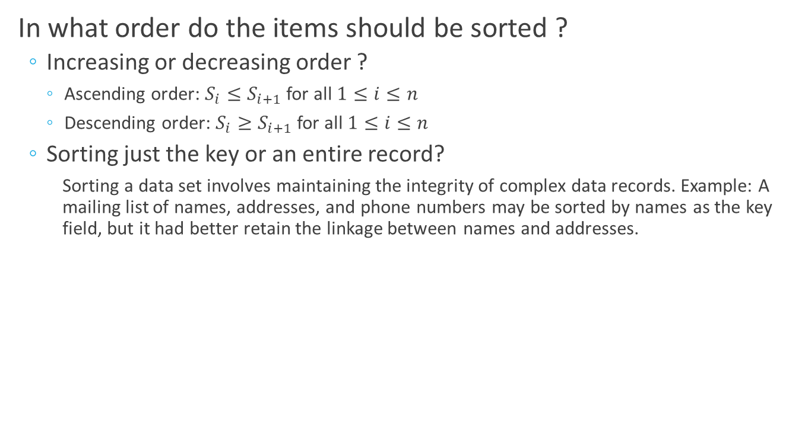
Pragmatics of Sorting
In what order do the items should be sorted ?
  Increasing or decreasing order ?
    Ascending order: $S_{i}≤S_{i+1}$ for all $1≤i≤n$
    Descending order: $S_{i}≥S_{i+1}$ for all $1≤i≤n$
  Sorting just the key or an entire record?
    Sorting a data set involves maintaining the integrity of complex data records. Example: A mailing list of names, addresses, and phone numbers may be sorted by names as the key field, but it had better retain the linkage between names and addresses.

Slide 11
Pragmatics of Sorting (2)
In what order do the items should be sorted ?
  Equal keys?
    Sometimes the relative order among elements with equal key values is important. Either they have a secondary key or enforce the relative order among these equal keys (stable).
  Non-numerical data ?
    The right way to specify such matters in the sorting algorithm is with an application-specific pairwise-element comparison function.

Slide 12
Running Time
Running time for Sorting Algorithms usually depend on the number of
  comparisons (for comparison-based algorithm)
  data movements or exchanges (or array access).

Slide 13
Running Time (2)
The number of comparisons and the number of movements do not have to coincide. Practical reasons must aid in the choice of which algorithm to use:
  comparisons become more important if strings or arrays of numbers are compared
  exchanges become more important if the data items are large (such as structure, record)

Slide 14
Running Time
Overall, efficiency is measured for the following cases:
  Best case : data already in order
  Worst case : data in reverse order
  Average case : data in random order

Slide 15
Selection Sort-Idea
Selection sort works by selecting an element and move it to its proper position :
  Assume we have an array of n integers with random order
  Find the smallest elements in the array
  Exchange the smallest elements with the first element in the array
  Starting from the second element, find the smallest element among the last n-1 elements
  Exchange it with the second element in the array
  Continue until only one element remain unsorted

Slide 16
Selection Sort-Illustration
21 | 40 | 5 | 62 | -123 | 15
-123 | 40 | 5 | 62 | 21 | 15
-123 | 5 | 40 | 62 | 21 | 15
-123 | 5 | 15 | 62 | 21 | 40
-123 | 5 | 15 | 21 | 62 | 40
-123 | 5 | 15 | 21 | 40 | 62

Slide 17
Selection Sort-Pseudocode
Problem : Sort an array of integers in ascending order
Input : Array A of integers, contains n integer
Output : All elements in A are sorted
1. SELECTION-SORT(A)
2. for i =1 to n-1 do
3. select the i-th smallest element
4. exchange with the i-th element
1. SELECTION-SORT(A)
2. for i =1 to n-1 do
3. min = i
4. for j = i+1 to n do
5. if A[j] < A[min]
6. min = j
7. exchange A[min]with A[i]

Slide 18
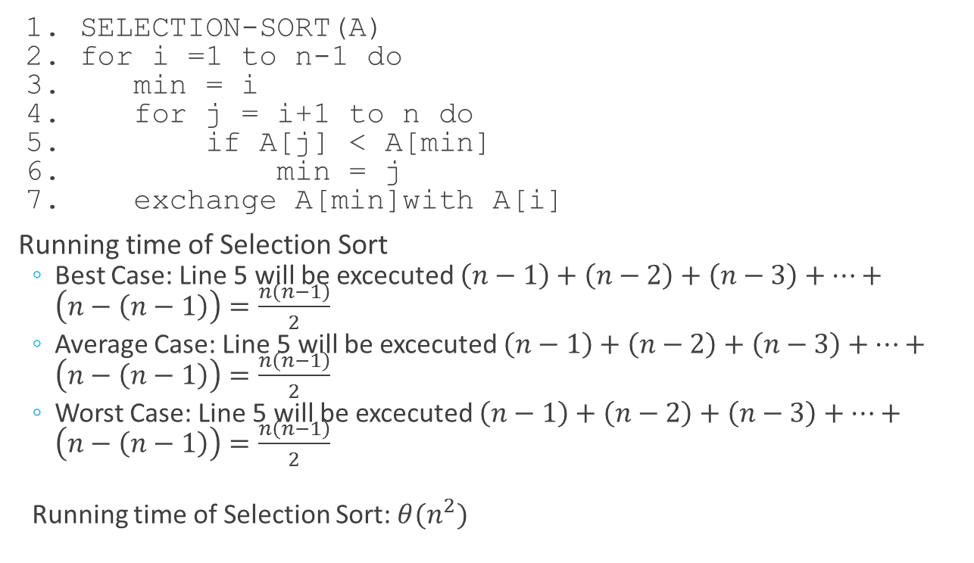
Selection Sort-Running Time
1. SELECTION-SORT(A)
2. for i =1 to n-1 do
3. min = i
4. for j = i+1 to n do
5. if A[j] < A[min]
6. min = j
7. exchange A[min]with A[i]
Running time of Selection Sort
  Best Case: Line 5 will be excecuted $\left(n−1\right)+\left(n−2\right)+\left(n−3\right)+…+\left(n−\left(n−1\right)\right)=\frac{n\left(n−1\right)}{2}$
  Average Case: Line 5 will be excecuted $\left(n−1\right)+\left(n−2\right)+\left(n−3\right)+…+\left(n−\left(n−1\right)\right)=\frac{n\left(n−1\right)}{2}$
  Worst Case: Line 5 will be excecuted $\left(n−1\right)+\left(n−2\right)+\left(n−3\right)+…+\left(n−\left(n−1\right)\right)=\frac{n\left(n−1\right)}{2}$
  Running time of Selection Sort: $θ(n^{2})$

Slide 19
Insertion Sort-Idea
Selection sort works by inserting an element into its proper position in already sorted (sub)-array:
  Assume we have an array of n integers with random order
  The first element in already sorted
  Insert the second element into already sorted sub-array contains the first element
  Now sub-array contains two elements is already sorted
  Repeat the process with the next (unsorted) element. The size of a sorted sub-array is growing.
  Continue until the last element is inserted and the array is sorted

Slide 20
Insertion Sort-Illustration
21 | 40 | 5 | 62 | -123 | 15
21 | 40 | 5 | 62 | -123 | 15
21 | 40 | 5 | 62 | -123 | 15
5 | 21 | 40 | 62 | -123 | 15
5 | 21 | 40 | 62 | -123 | 15
-123 | 5 | 21 | 40 | 62 | 15
-123 | 5 | 15 | 21 | 40 | 62

Slide 21
Insertion Sort-Pseudocode
Problem : Sort an array of integers in ascending order
Input : Array A of integers, contains n integer
Output : All elements in A are sorted
1. INSERTION-SORT(A)
2. for i = 2 to n do
3. insert the i-th element into the right position in a sorted sub-array A[1...i-1]
1. INSERTION-SORT(A)
2. for i = 2 to n do
3. j = i - 1
4. key = A[i]
5. while j > 0 AND key < A[j] do
6. A[j+1]=A[j]
7. j = j -1
8. A[j+1] = key

Slide 22
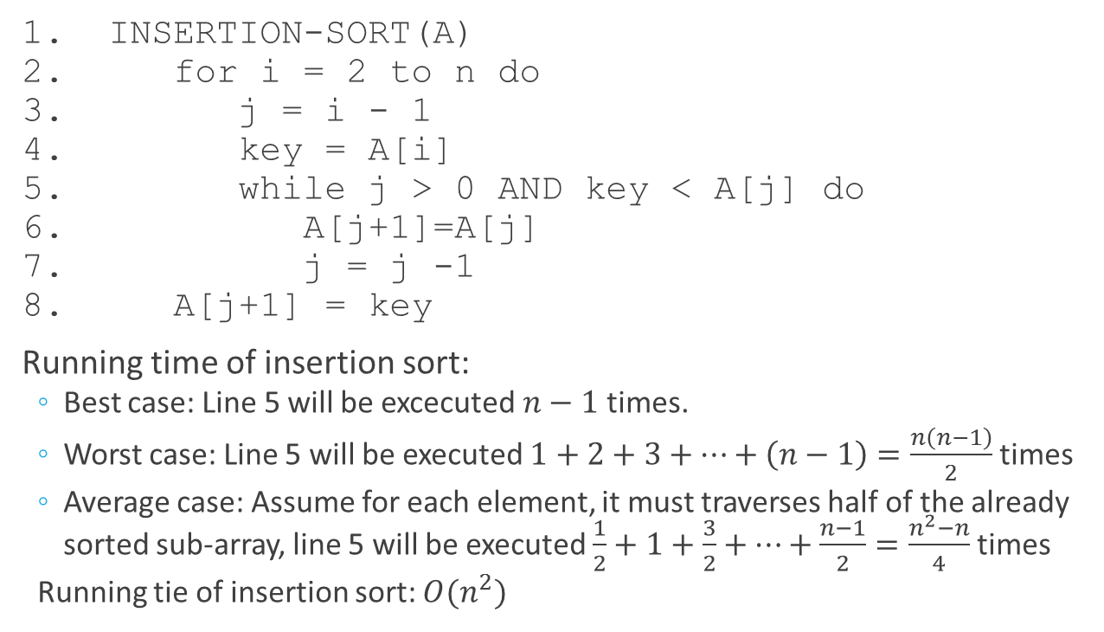
Insertion Sort-Running Time
1. INSERTION-SORT(A)
2. for i = 2 to n do
3. j = i - 1
4. key = A[i]
5. while j > 0 AND key < A[j] do
6. A[j+1]=A[j]
7. j = j -1
8. A[j+1] = key
Running time of insertion sort:
  Best case: Line 5 will be excecuted $n−1$ times.
  Worst case: Line 5 will be executed $1+2+3+…+\left(n−1\right)=\frac{n\left(n−1\right)}{2}$ times
  Average case: Assume for each element, it must traverses half of the already sorted sub-array, line 5 will be executed $\frac{1}{2}+1+\frac{3}{2}+…+\frac{n−1}{2}=\frac{n^{2}−n}{4}$ times
  Running tie of insertion sort: $O(n^{2})$

Slide 23
Sorting in JDK
Sorting primitive types: Java provides Arrays.sort
Example:
1. int[] A= {7,5,61,4,2};
2. Arrays.sort(A);
3. System.our.println(Arrays.toString(A)); //prints 2, 4, 5, 7, 61

Slide 24
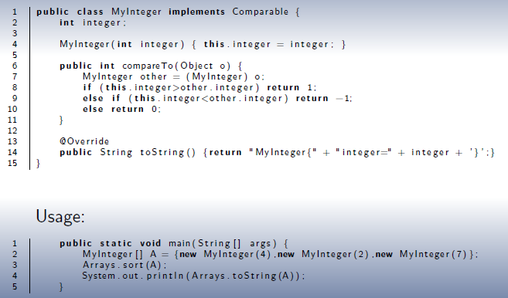
Sorting in JDK
To sort an array of object, object must implements comparable and override method compareTo().

Slide 25
Homeworks
Watch Insertion sort with Romanian Dance
Watch Selection sort Gypsi Folk Dance
Watch Bubble Sort with Hungarian Dance
Sort the array of characters S={E,A,S,Y,Q,U,E,S,T,I,O,N} with insertion, selection, and bubble sort! (Submit to elearning→HW0401.doc or docx)
Answer the insertion sort quiz! (Submit to elearning→HW0402.doc or docx)
Answer the selection sort quiz! (Submit to elearning→HW0403.doc or docx)
Finish the practicuum modul!

Slide 26
Shell Sort-Idea
ShellSort is an upgrade over Insertion Sort (It was created by Donald L. Shell in 1959):
  Selection Sort: moves element efficiently, but does many redundant comparison
  Insertion Sort: minimum number comparison (at average), but inefficient by moving element one position at a time
  ShellSort (Diminishing-increment Sort) is an extension of insertion sort, it allows exchanging array elements that are far apart
  It divides the array into several sub-arrays containing elements far apart (not contiguous but every h-th element, h is gap between elements) and sort each of sub-arrays, eventually move small elements relatively in front of others
  This process is repeated (with decreasing value of h) and it will produce partially sorted arrays that can be efficiently sorted, eventually by Insertion Sort

Slide 27
Shell Sort Illustration
Assume we have an array of n integers with random order.
The values of h used is 4, 3 and 1.
The first sub-array {21, -123} with h = 4 is sorted
The second sub-array with h = 4 is sorted
The third sub-array with h = 4 is sorted
21 | 40 | 5 | 62 | -123 | 15
-123 | 40 | 5 | 62 | 21 | 15
-123 | 40 | 5 | 62 | 21 | 15
-123 | 15 | 5 | 62 | 21 | 40
-123 | 15 | 5 | 62 | 21 | 40

Slide 28
Shell Sort Illustration(2)
The fourth sub-array with h = 4 is sorted
Continue with h = 3. The first sub-array {-123,62} with h = 3 is sorted
The second sub-array with h = 3 is sorted
The third sub-array with h = 3 is sorted
Finally, sort it with h = 1
-123 | 15 | 5 | 62 | 21 | 40
-123 | 15 | 5 | 62 | 21 | 40
-123 | 15 | 5 | 62 | 21 | 40
-123 | 15 | 5 | 62 | 21 | 40
-123 | 5 | 15 | 21 | 40 | 62

Slide 29
Shell Sort-Pseudocode
Problem : Sort an array of integers in ascending order
Input : Array A of integers, contains n integer & Array of integers H, sorted in ascending order
Output : All elements in A are sorted
1. SHELLSORT(A,H)
2. for k = H.length downto 1 do
3. h = H[ k ]
4. divide array into h subarray and sort each subarray

Slide 30
Shell Sort-Pseudocode(2)
1. SHELLSORT(A,H)
2. for k = H.length downto 1 do
3. h = H[k]
4. for i = h+1 to n do
5. j = i
6. tmp = A[ i ]
7. while(j>=h) AND A[j-h]>temp do
8. A[j] = A[j-h]
9. j = j-h
10. A[j] = tmp

Slide 31

Shell Sort-Running Time
Running time of shell sort depends on the choice of h (gaps):
  Best Case: $θ(n)$
  Worst Case: $θ(n^{2})$ (Shell,1959), $O(n^{\frac{4}{3}})$(Sedgewick,1986)

