Slide 1
Pengantar Metode NUmerik

Slide 2
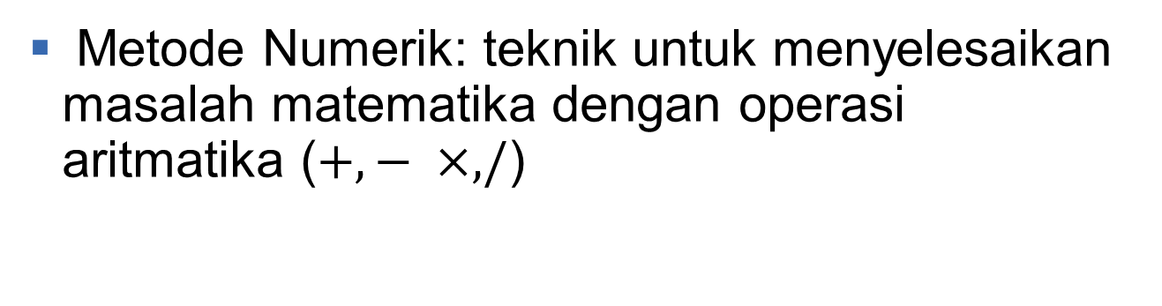
Motivasi
Metode Numerik: teknik untuk menyelesaikan masalah matematika dengan operasi aritmatika ($+, − ×, /$)

Slide 3
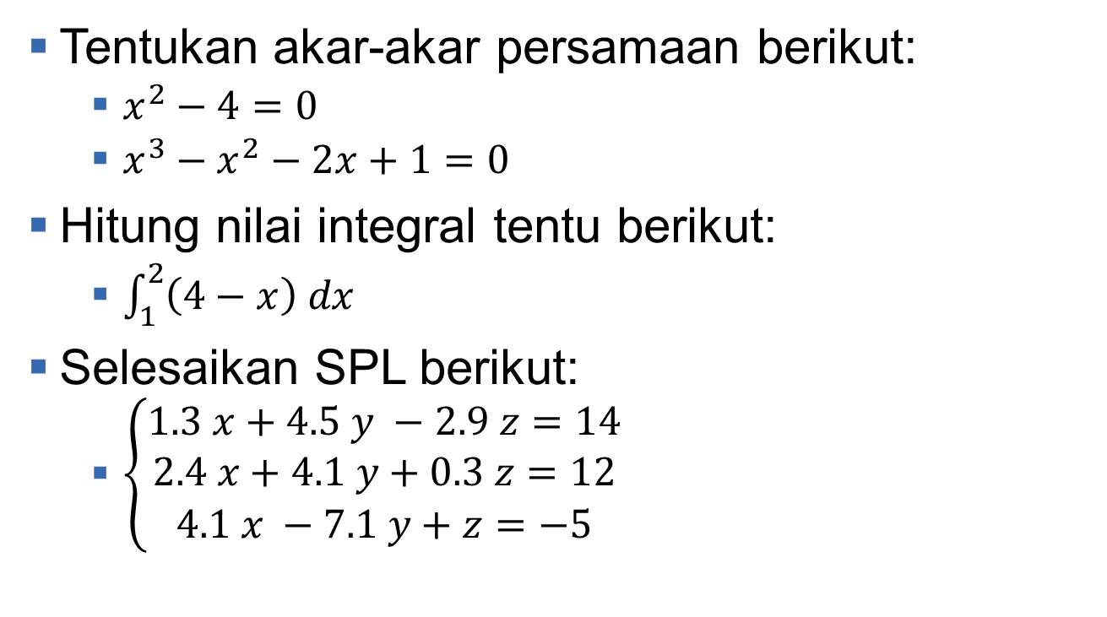
Contoh persoalan matematika
Tentukan akar-akar persamaan berikut:
$x^{2}−4=0$
$x^{3}−x^{2}−2x+1=0$
Hitung nilai integral tentu berikut:
$\int_{1}^{2}{\left(4−x\right) dx}$
Selesaikan SPL berikut:
$\left\{\begin{aligned}1.3 x+4.5 y −2.9 z=14 \\ 2.4 x+4.1 y+0.3 z=12 \\ 4.1 x −7.1 y+z=−5\end{aligned}\right.$

Slide 4
Metode penyelesaian masalah matematika
Ada dua metode untuk menyelesaikan masalah matematika:
Secara analitik
Secara numerik

Slide 5
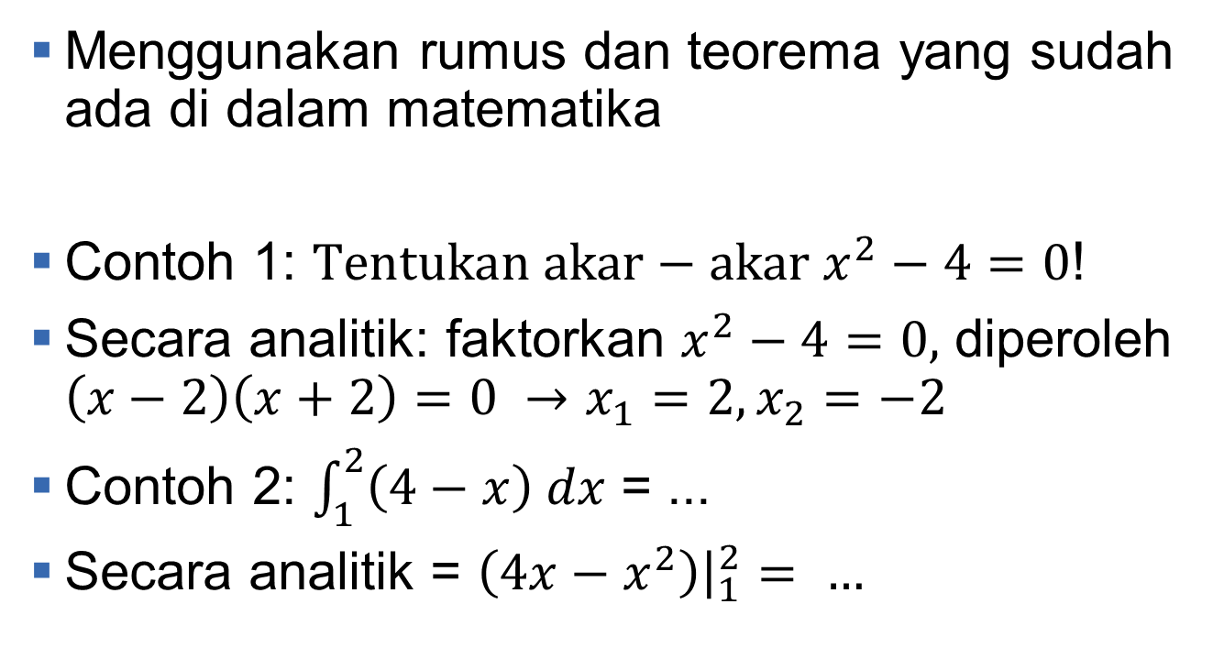
Metode analitik (EKSak)
Menggunakan rumus dan teorema yang sudah ada di dalam matematika
Contoh 1: $Tentukan akar−akar x^{2}−4=0$!
Secara analitik: faktorkan $x^{2}−4=0,$ diperoleh $\left(x−2\right)\left(x+2\right)=0 →x_{1}=2, x_{2}=−2$
Contoh 2: $\int_{1}^{2}{\left(4−x\right) dx}$ = ...
Secara analitik = $\left(4x−x^{2}\right){\left.​\right|}_{1}^{2}= …$

Slide 6
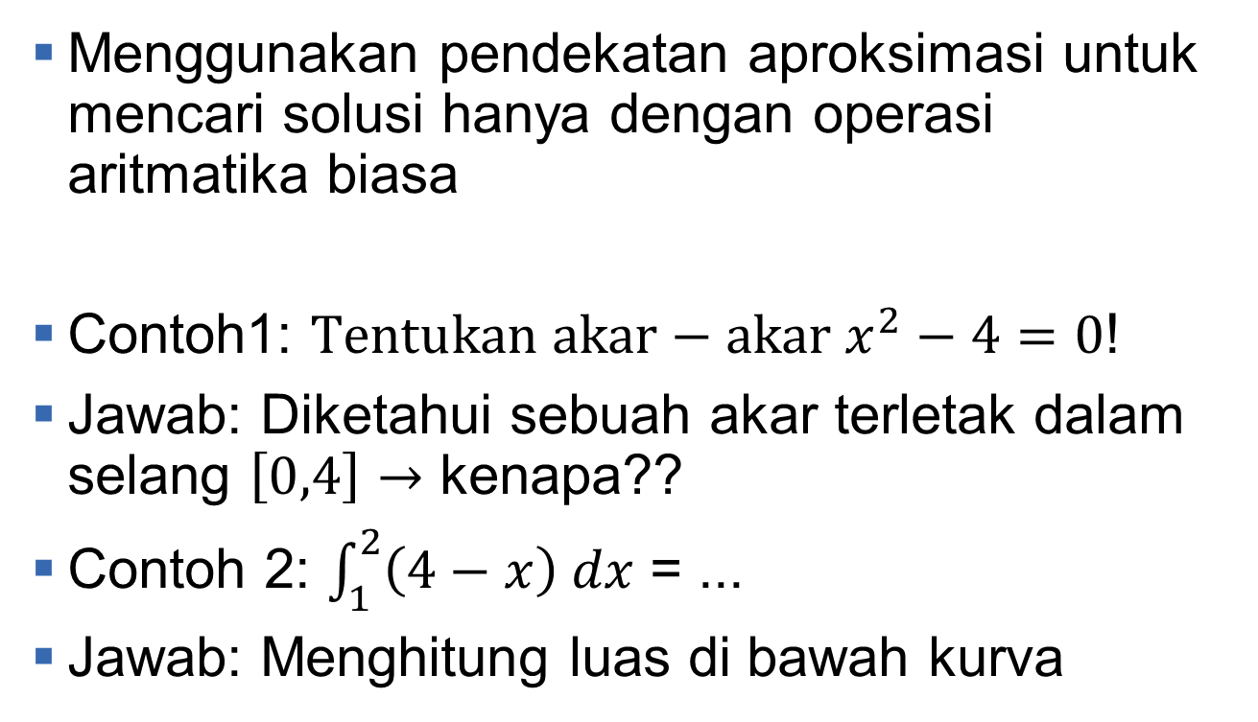
Metode Numerik
Menggunakan pendekatan aproksimasi untuk mencari solusi hanya dengan operasi aritmatika biasa
Contoh1: $Tentukan akar−akar x^{2}−4=0$!
Jawab: Diketahui sebuah akar terletak dalam selang $\left[0,4\right]→$ kenapa??
Contoh 2: $\int_{1}^{2}{\left(4−x\right) dx}$ = ...
Jawab: Menghitung luas di bawah kurva

Slide 7
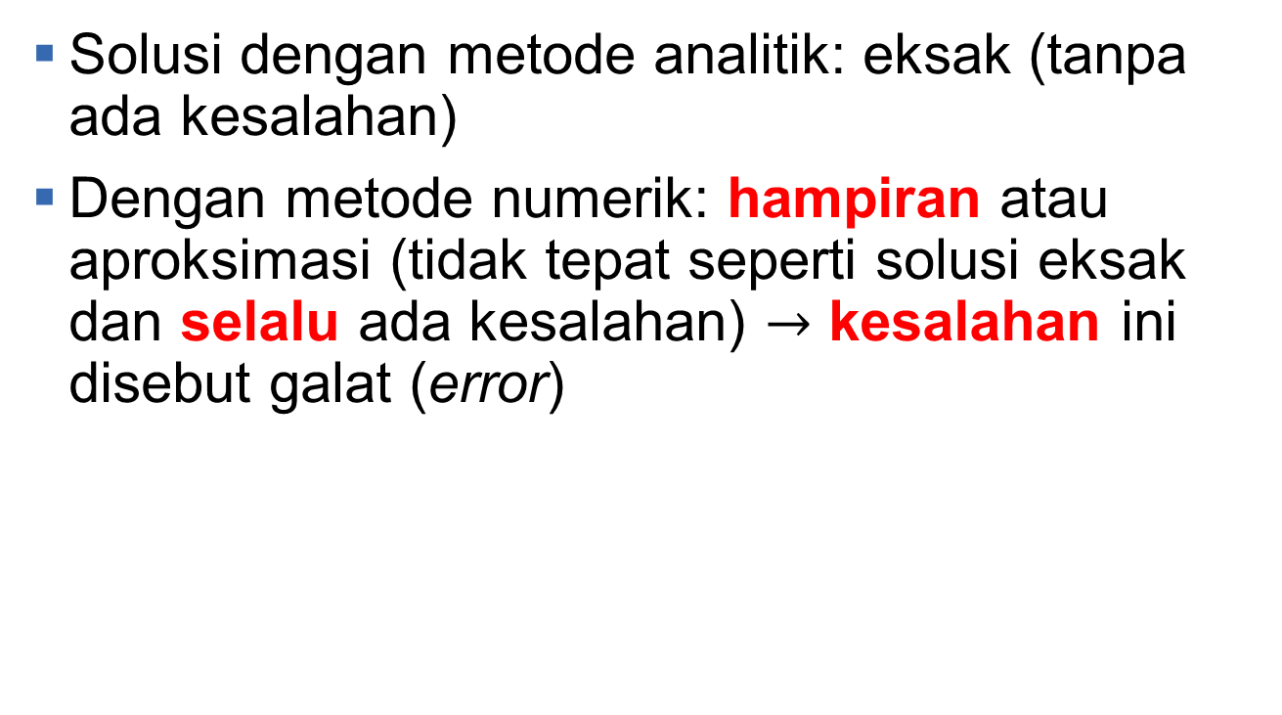
Perbedaan analitik dan numerik (1)
Solusi dengan metode analitik: eksak (tanpa ada kesalahan)
Dengan metode numerik: hampiran atau aproksimasi (tidak tepat seperti solusi eksak dan selalu ada kesalahan) $→$ kesalahan ini disebut galat (error)

Slide 8
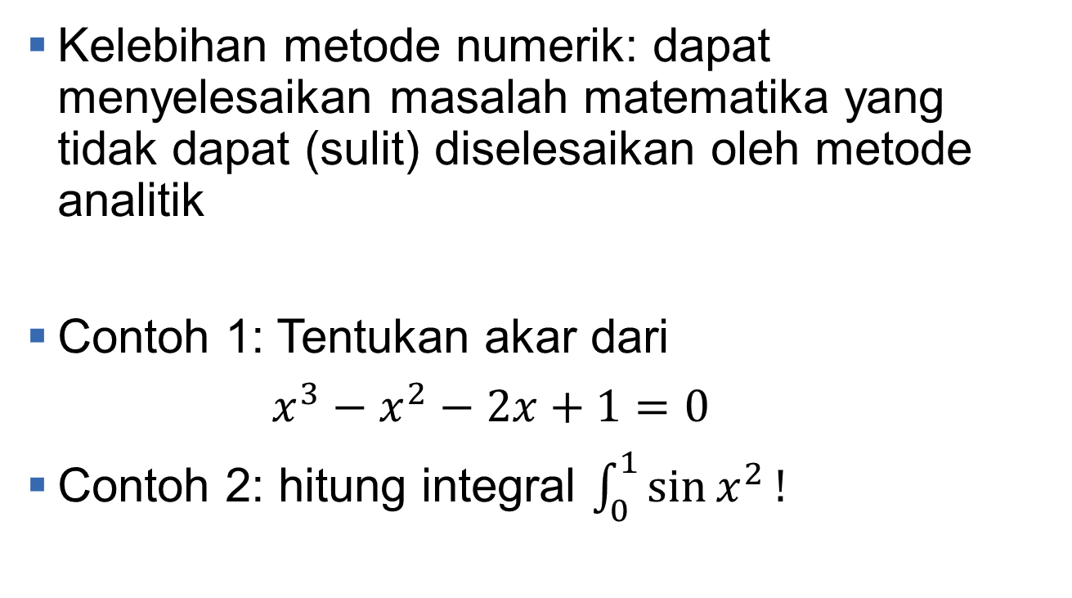
Perbedaan analitik dan numerik (2)
Kelebihan metode numerik: dapat menyelesaikan masalah matematika yang tidak dapat (sulit) diselesaikan oleh metode analitik
Contoh 1: Tentukan akar dari
$x^{3}−x^{2}−2x+1=0$
Contoh 2: hitung integral $\int_{0}^{1}{\sin{x^{2}}!}$

Slide 9
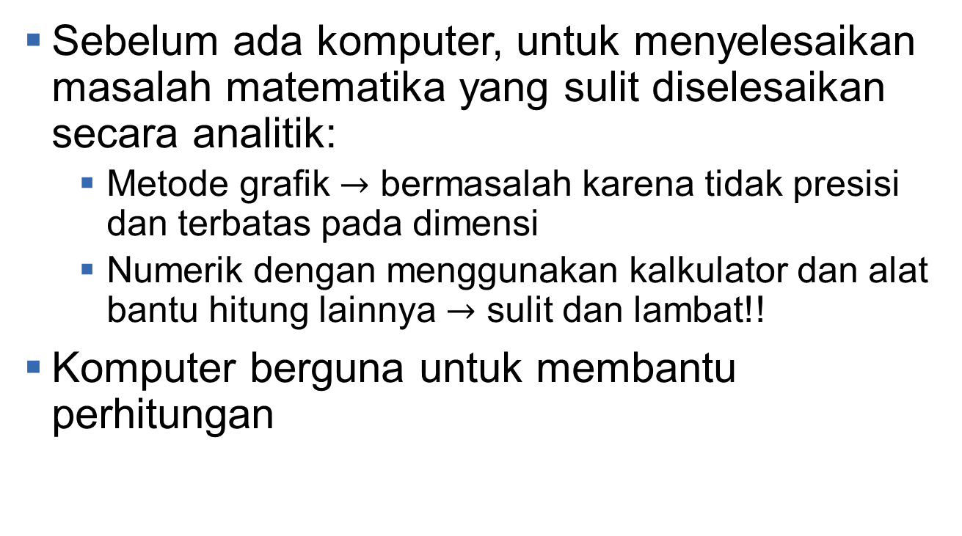
Pre computer era
Sebelum ada komputer, untuk menyelesaikan masalah matematika yang sulit diselesaikan secara analitik:
Metode grafik $→$ bermasalah karena tidak presisi dan terbatas pada dimensi
Numerik dengan menggunakan kalkulator dan alat bantu hitung lainnya $→$ sulit dan lambat!!
Komputer berguna untuk membantu perhitungan

Slide 10
Tahapan penyelesaian masalah secara numerik
Pemodelan
Penyederhanaan model
Menentukan metode numerik yang dipakai
Membuat algoritma
Implementasi algoritma pada bahasa pemrograman
Pengujian
Evaluasi

Slide 11
Materi kuliah
Mencari akar persamaan tak linear
Menyelesaikan sistem persamaan
Pencocokan kurva
Interpolasi
Optimasi
Integrasi Numerik

Slide 12
Penilaian kuliah
Tugas dan Kuis :30%
UTS :35%
UAS :35%

Slide 13
Buku teks
Richard L.Burden, J. Douglas Faires, Numerical Analysis, Brooks/Cole, Ninth Ed.
Curtis F. Gerald, Pattrick O. Wheatley, Applied Numerical Analysis, Fourth Ed., Addison-Wesley Publishing Company

Slide 14
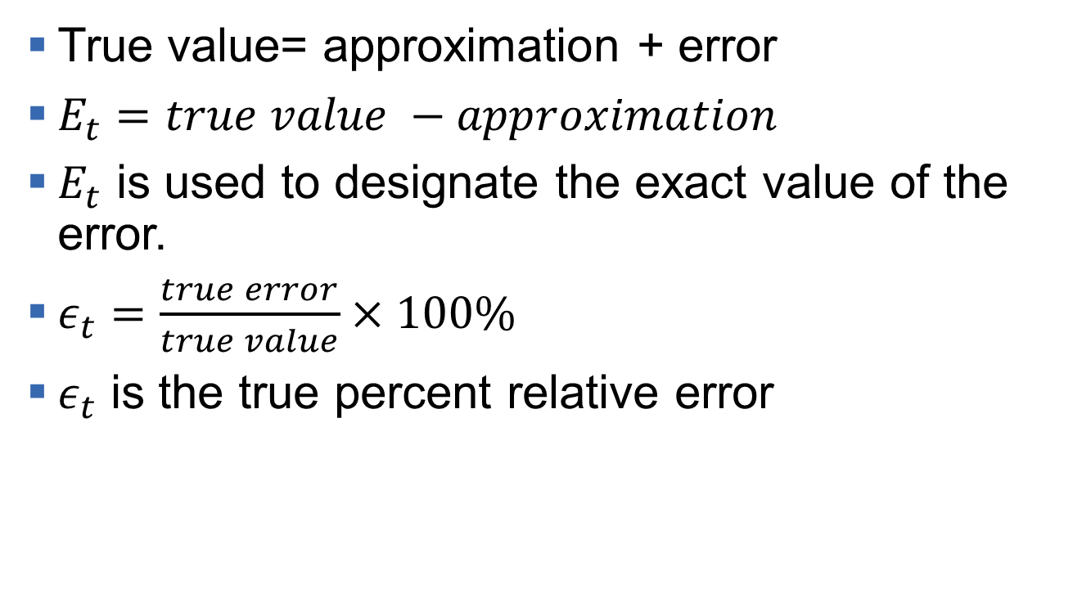
Error
True value= approximation + error
$E_{t}=true value −approximation$
$E_{t}$ is used to designate the exact value of the error.
$ε_{t}=\frac{true error}{true value}×100\%$
$ε_{t}$ is the true percent relative error

Slide 15
Example
Suppose that you have the task of measuring the lengths of a bridge and a river adn come up with 9999 and 9 cm, respectively. If the true values are 10.000 and 10 cm, respectively, compute (a) the true error and (b) the true percent relative error for each case.

Slide 16
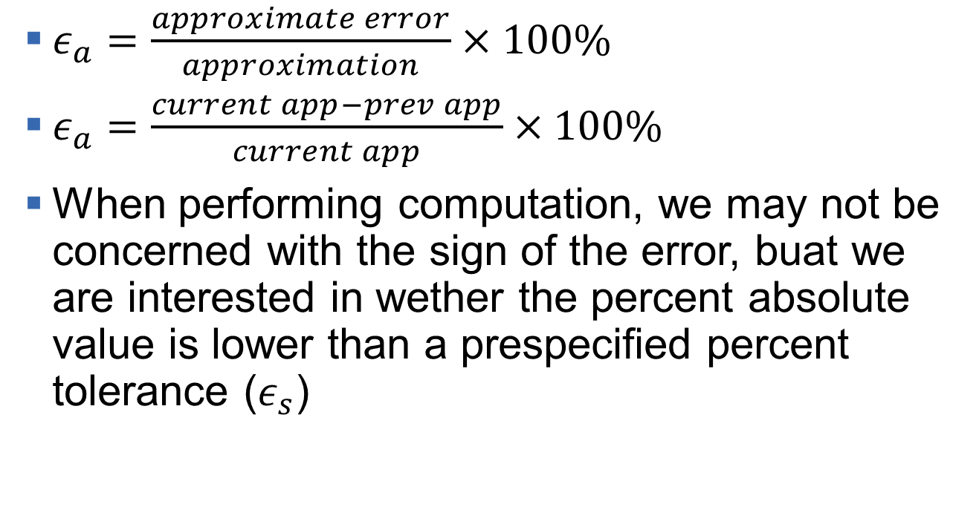
Error approximate (1)
$ε_{a}=\frac{approximate error}{approximation}×100\%$
$ε_{a}=\frac{current app−prev app}{current app}×100\%$
When performing computation, we may not be concerned with the sign of the error, buat we are interested in wether the percent absolute value is lower than a prespecified percent tolerance ($ε_{s}$)

Slide 17
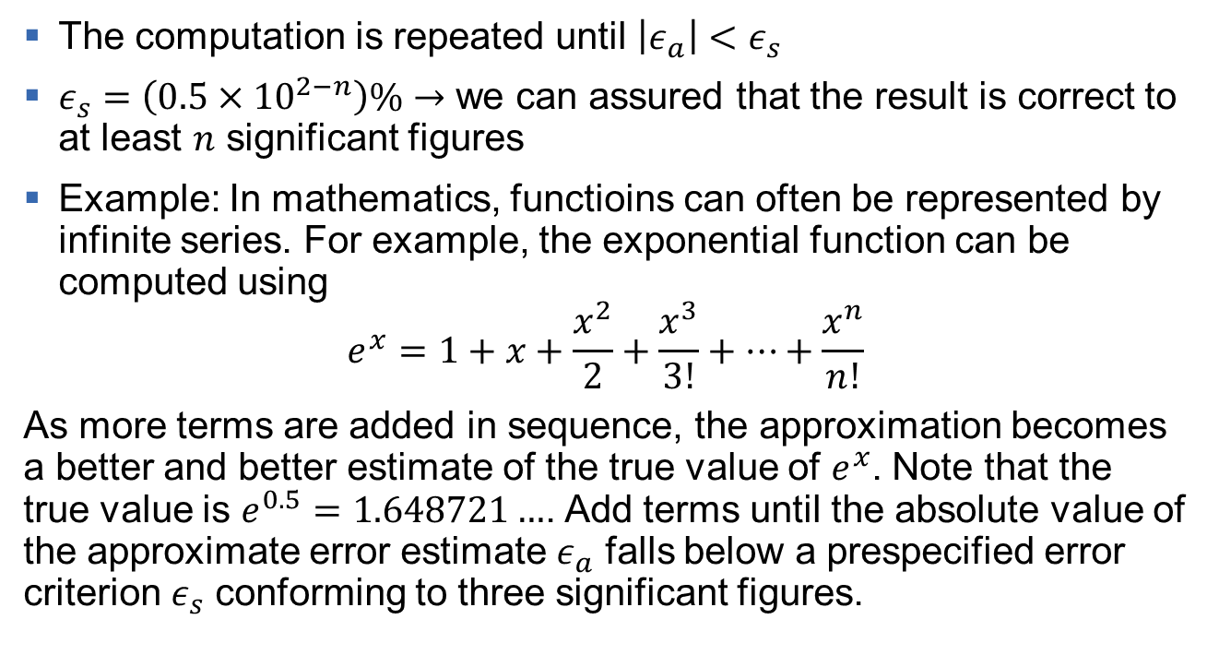
Error approximate (2)
The computation is repeated until $\left|ε_{a}\right|<ε_{s}$
$ε_{s}=\left(0.5×{10}^{2−n}\right)\%→$ we can assured that the result is correct to at least $n$ significant figures
Example: In mathematics, functioins can often be represented by infinite series. For example, the exponential function can be computed using
$$e^{x}=1+x+\frac{x^{2}}{2}+\frac{x^{3}}{3!}+…+\frac{x^{n}}{n!}$$
As more terms are added in sequence, the approximation becomes a better and better estimate of the true value of $e^{x}$. Note that the true value is $e^{0.5}=1.648721…$. Add terms until the absolute value of the approximate error estimate $ε_{a}$ falls below a prespecified error criterion $ε_{s}$ conforming to three significant figures.

Slide 18
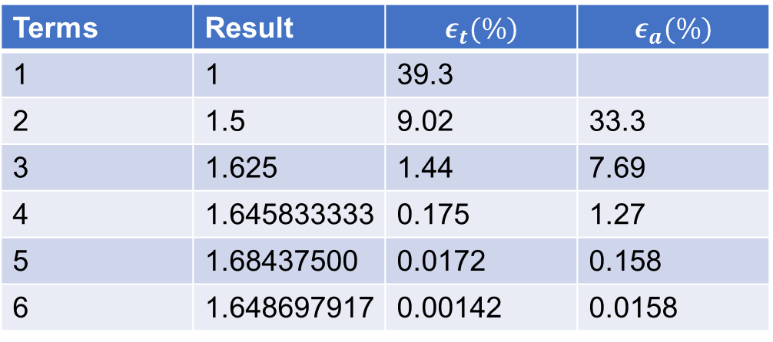

Error approximate (3)
$ε_{s}=\left(0.5×{10}^{2−3}\right)\%=0.05 \%$
We will add terms to the series until $ε_{a}$ falls below this level
After six terms are included, the approximate error falls below $ε_{s}=0.05\%$ and the computation is terminated. This ensure that the result is correct to at least three significant figures.
Terms | Result | $$ε_{t}(\%)$$ | $$ε_{a}(\%)$$
1 | 1 | 39.3
2 | 1.5 | 9.02 | 33.3
3 | 1.625 | 1.44 | 7.69
4 | 1.645833333 | 0.175 | 1.27
5 | 1.68437500 | 0.0172 | 0.158
6 | 1.648697917 | 0.00142 | 0.0158

Slide 19
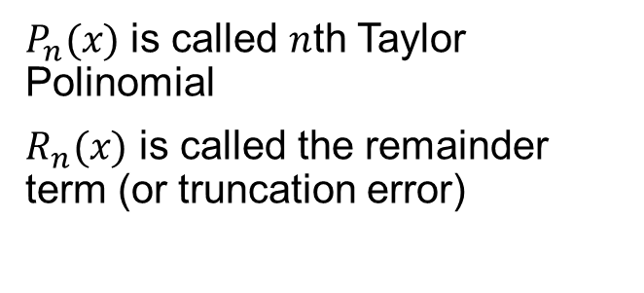
Truncation error(1)
$P_{n}(x)$ is called $n$th Taylor Polinomial
$R_{n}(x)$ is called the remainder term (or truncation error)

Slide 20
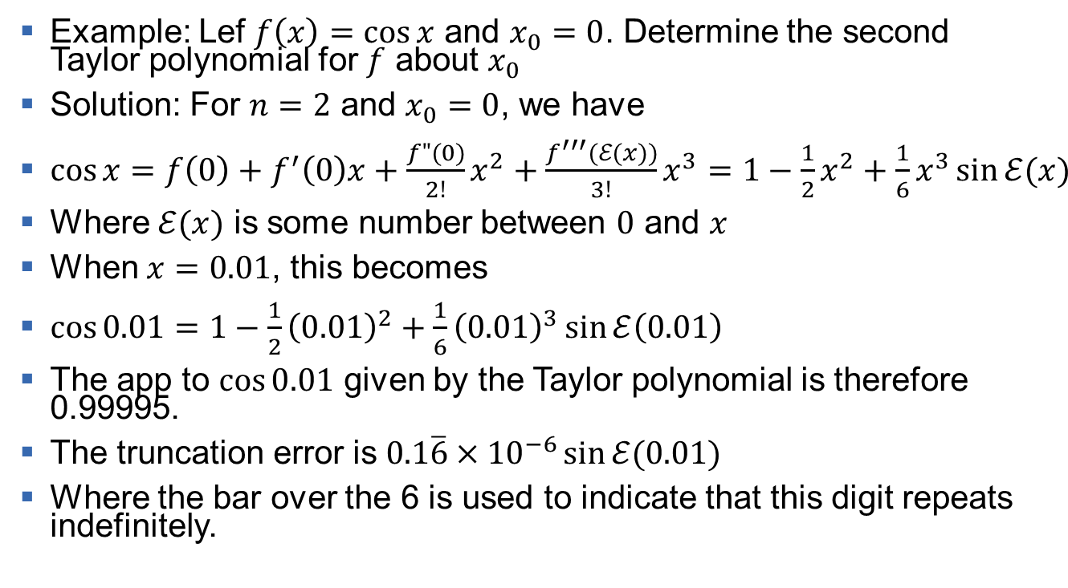
Truncation error(2)
Example: Lef $f\left(x\right)=\cos{x}$ and $x_{0}=0$. Determine the second Taylor polynomial for $f$ about $x_{0}$
Solution: For $n=2$ and $x_{0}=0$, we have
$\cos{x=f\left(0\right)+f^{′}\left(0\right)x+\frac{f"(0)}{2!}x^{2}+\frac{f^{′′′}(ℰ(x))}{3!}x^{3}=1−\frac{1}{2}x^{2}+\frac{1}{6}x^{3}\sin{ℰ(x)}}$
Where $ℰ(x)$ is some number between $0$ and $x$
When $x=0.01$, this becomes
$\cos{0.01}=1−\frac{1}{2}{\left(0.01\right)}^{2}+\frac{1}{6}{\left(0.01\right)}^{3}\sin{ℰ\left(0.01\right)}$
The app to $\cos{0.01}$ given by the Taylor polynomial is therefore 0.99995.
The truncation error is $0.1\overline{6}×{10}^{−6}\sin{ℰ(0.01)}$
Where the bar over the 6 is used to indicate that this digit repeats indefinitely.

Slide 21

Truncation error(3)
Although we have no way of determining $ℰ\left(0.01\right),$ we know that all values of the sine lie in the interval $[−1,1]$, so the error occurring if we use approximation $0.99995$ is bounded by
$\left|\cos\left(0.01\right)−0.99995\right|≤0.1\overline{6}×{10}^{−6}$

